Slide 1
Maine’s Value-Based Insurance Design
Robin Allen
Value-Based Insurance Design Manager
2-17-15

Slide 2
Value Based Insurance Design
A form of benefit design that promotes the use of healthcare services and providers that provide more “value” over those services and providers that provide less.

Slide 3
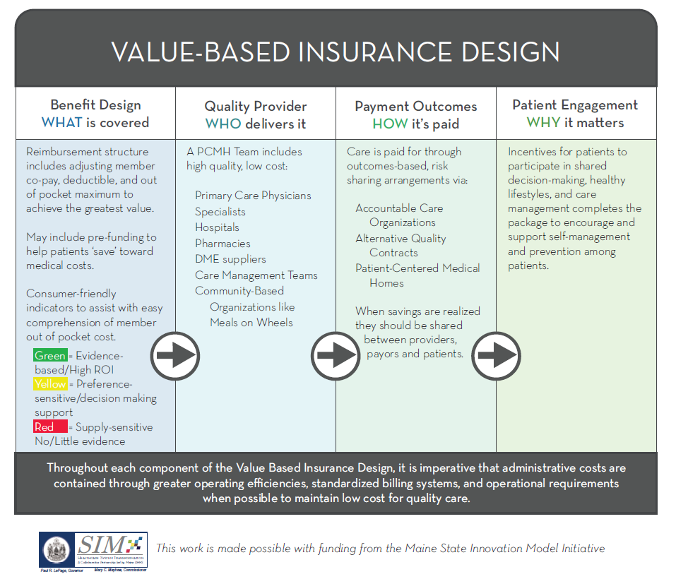
MHMC VBID Plan Design

Slide 4
MHMC VBID Plan Design
1

Slide 5
Using EMR’s To Aid in Communication
Clearing the Path to High ROI Service Use
Slow Down and Review Options
Stop and Look at the Evidence Before Proceeding
Goal: Reduce Unnecessary Services $265 Billion IOM

Slide 6
Clinical Approach
USPSTF A & B, HRSA Bright Futures, & ACIP Vaccination Recommendations
GRADE | TOPIC | ACA REQUIREMENT | ADDITIONAL CONSIDERATIONS | VBID RECOMMENDATION | ADMINISTRATION/COST SAVING OPPORTUNITY | RECOMMENDED CATEGORY
USPSTF B | Abdominal aortic aneurysm screening: men | one-time screening for abdominal aortic aneurysm by ultrasonograph in men ages 65-70 who have smoked |  | Implement as required as a preventive screening with no patient out of pocket cost. | Compliance with ACA requirement | GREEN
USPSTF B | Alcohol misuse: screening and counseling | Screen adults 18 and over for alcohol misuse and provide persons engaged in risky or hazardous drinking with brief behavioral counseling | Cover first 3 visits at 100% when performed by a licensed mental health provider | Implement as required as a preventive screening with no patient out of pocket cost. There are CPT/HCPCS codes for alcohol/SA (exc. Tobacco) screening and intervention. | Compliance with ACA requirement | GREEN
USPSTF B | Anemia screening: pregnant women | Routine screening for iron deficiency anemia in asymptomatic pregnant women |  | Implement as required as a preventive screening with no patient out of pocket cost. | Compliance with ACA requirement | GREEN
USPSTF A | Aspirin to prevent cardiovascular disease: men | Use of aspirin for men ages 45 to 79 years when the potential benefit due to a reduction in myocardial infarctions outweighs the potential harm due to an increase in gastrointestinal hemorrhage. | Aspirin is currently covered under the pharmacy benefit if the patient needs it. Aspirin use recommendation is part of office visit | Consider whether tracking is necessary to ensure aspirin is being recommended as outlined. | Potential to reduce health costs related to MI. | GREEN
USPSTF A | Aspirin to prevent cardiovascular disease: women | Use of aspirin for women ages 55 to 79 years when the potential benefit of a reduction in ischemic strokes outweighs the potential harm of an increase in gastrointestinal hemorrhage. | Aspirin is currently covered under the pharmacy benefit if the patient needs it. Aspirin use recommendation is part of office visit | Consider whether tracking is necessary to ensure aspirin is being recommended as outlined. | Potential to reduce health costs related to MI. | GREEN
USPSTF A | Bacteriuria screening: pregnant women | Screening for asymptomatic bacteriuria with urine culture in pregnant women at 12 to 16 weeks' gestation or at the first prenatal visit, if later. |  | Implement as required as a preventive screening with no patient out of pocket cost. | Compliance with ACA requirement | GREEN
USPSTF A | Blood pressure screening in adults | Screening for high blood pressure in adults age 18 years and older. | Blood pressure screening is part of office visit | Implement as required as a preventive screening with no patient out of pocket cost. | Compliance with ACA requirement

Slide 7
MHMC VBID Plan Design
4

Slide 8
Making the Patient Part of the Team
Employ incentives and disincentives to produce healthy lifestyle choices and support management of chronic illness:
At the community level
Goal: Take advantage of missed preventive opportunities $55 Billon IOM

Slide 9
MHMC VBID Plan Design
5

Slide 10
Administrative Simplification
Identify areas of improvement through provider/member complaint logs and patient, provider, health plan, and advocate insights then simplify processes to reduce administration cost burden through process improvement
Reduce complexity through standardization across public and private payers through consistency where possible (claim billing, prior-authorization)
Adjust plan benefits so they encourage the desired behavior in all parties
Goal: Reduce Excessive Administrative Costs $190 Billion IOM

Slide 11
Community Effort
Health Plans/Payers
Aetna
Cigna
Anthem
Harvard Pilgrim Health Plan
Maine Community Health Options
Medical Mutual
Geisinger
MaineCare
Brokers
Providers/Associates
State & Federal
Others

Slide 12
Community Effort
Health Plans/Payers
Brokers
Cross Agency
Holden Agency
USI
Aliant
Acadia Benefits
Providers/Associates
State & Federal
Others

Slide 13
Community Effort
Health Plans/Payers
HealthReach
Maine Optometric Association
MaineHealth
Maine General
OMC Wellness
St. Mary’s
Spurwink
MidCoast Health
InterMed
Maine Osteopathic Association
Brokers
Providers/Associates
State & Federal
Others

Slide 14
Community Effort
Health Plans/Payers
Centers for Medicare & Medicaid Innovation
Maine State Employee Health and Benefits Office
Maine CDC
Veteran’s Administration
MEABT
Maine BOI
DHHS
Brokers
Providers/Associates
State & Federal
Others

Slide 15
Community Effort
Health Plans/Payers
Lown Institute-MA
IMD Foundation-MA
City of Portland
Maine Quality Counts
Maine Areas on Aging
Health Care Administrative Solutions, Inc.-MA
Brian Atchison
Milliman MedInsight – Waste Calculator-WA
Athena
www.TheNNT.com
Brokers
Providers/Associates
State & Federal
Others

Slide 16
Community Effort
Health Plans/Payers
Robert Wood Johnson Foundation-NJ
Oregon State-OR
Internal MHMC staff
Neel Shah, Costs of Care-MA
Integrated Health Association-CA
Pacific Business Group on Health-CA
AARP
Brokers
Providers/Associates
State & Federal
Others
Continued

Slide 17
Questions?
Contact: Robin Allen at rallen@mehmc.org or 207 844-8106 extension 244 with suggestions or to join a subcommittee

